Slide 1
.NET Core Workshop
Mariano Sánchez
sanchezmariano@outlook.com @marianosz
http://weblogs.asp.net/marianos

Slide 2
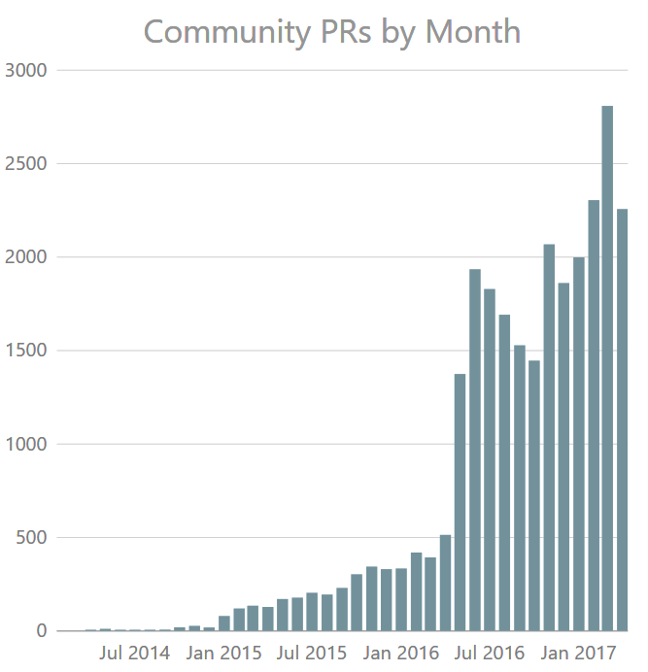





Open source momentum
Community PRs by month
“Samsung is embracing .NET because it is a completely open source project.”
"ASP.NET is open source, that allows us to contribute back to it if we have any performance issues which Microsoft review and together we make a better product.“
— Illyriad Games

Slide 3
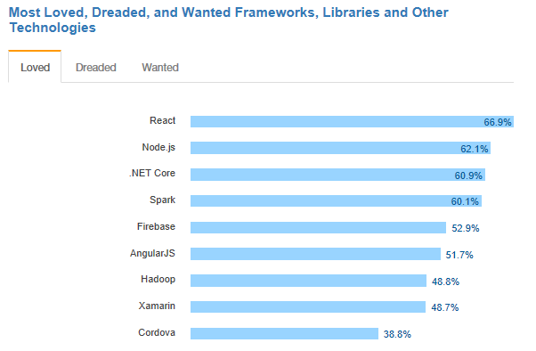
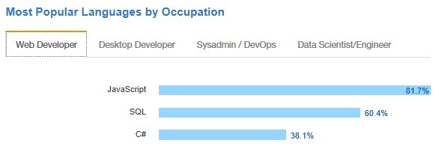
.NET is active and growing
.NET Core debuts at #3 most loved Framework on Stack Overflow Technology Survey 2017
C# is #3 most popular language for desktop and web developers on Stack Overflow Technology Survey 2017
Source: http://stackoverflow.com/insights/survey/2017

Slide 4

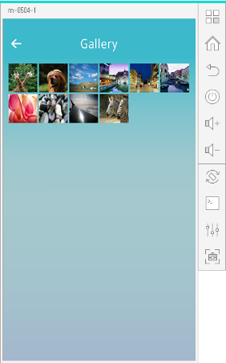
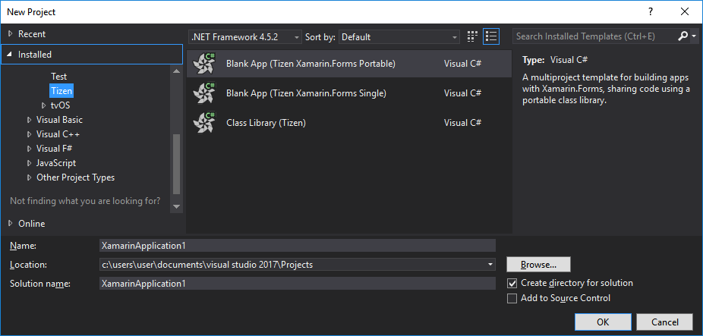
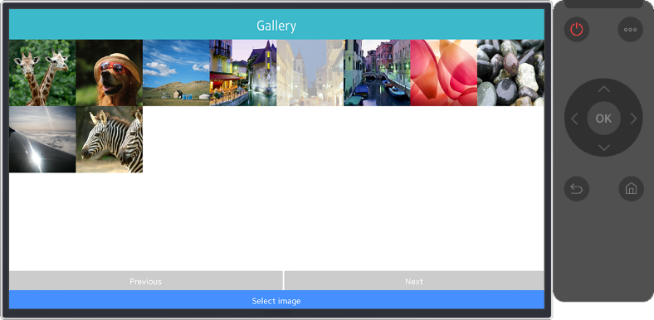
.NET Core Support on Tizen
Build Tizen apps for mobile devices and TVs with .NET Core and Xamarin.Forms
Preview #1
Preview #2
Preview #3
Preview #4
Official Release
Mobile
Nov 2016
Mobile/TV
Jan 2017
Mobile/TV
Mar 2017
Mobile/TV
June 2017
Mobile/TV
End of 2017
Visual Studio Tools for Tizen
Supports everything you need to
develop Tizen apps with .NET
https://developer.tizen.org/development/tizen-.net-preview/

Slide 5
Guidance

Slide 6
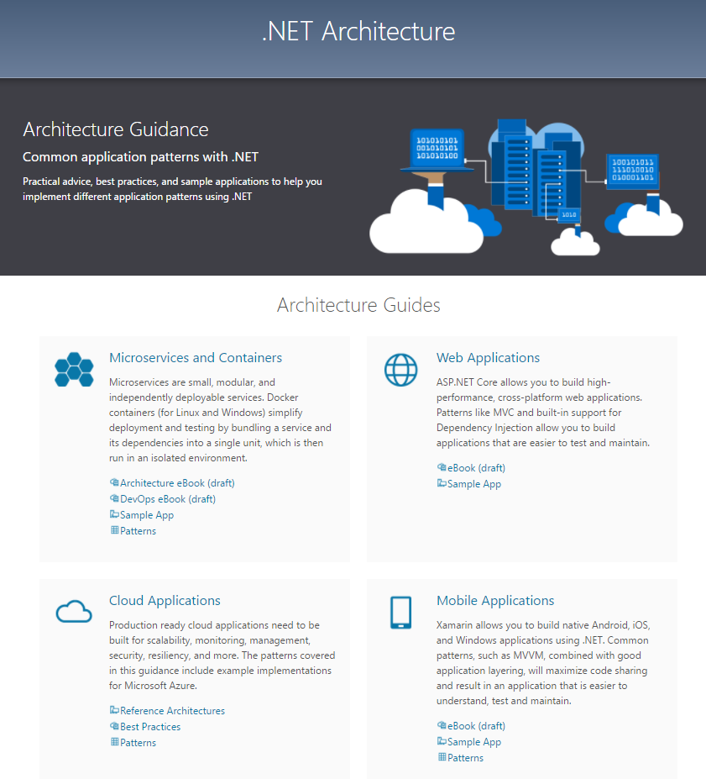

Slide 7
.NET Architecture
Available now at: https://dot.net/architecture
eBooks & samples: Web, Containers, mobile
Patterns: Health checks, queueing
More books and patterns coming…

Slide 8

Announcing .NET Conf 2017
September 19–21
Immerse yourself in the world of .NET
Join us for 3 days of free online content, brought to you by the .NET community and Microsoft product teams
For more information: http://www.dotnetconf.net

Slide 9
Code Sharing

Slide 10
.NET Standard library
One library to rule them all
Learn one API across ALL .NET platforms
Reuse your code across ALL .NET platforms
Easily consume third-party/OSS libraries across ALL .NET platforms
.NET Standard 1.x
Evolution of Portable Class Libraries (PCLs) with a much simpler model
Two constraints:
API surface relatively small, because .NET Core was small
Can’t reference the vast number of libraries already available for .NET Framework

Slide 11


.NET Standard
WINDOWS
DESKTOP
CLOUD MICROSERVICES
WINDOWS UWP
IOS, ANDROID
GAMES/ 3D
Visual Studio
.NET STANDARD
Visual Studio for Mac
INFRASTRUCTURE
COMPILERS
LANGUAGES
RUNTIME COMPONENTS
Visual Studio Code
.NET Standard allowsa sharing code, binaries, and skills between .NET client, server, and all flavors
.NET Standard provides a specification for any platform to implement
All .NET runtimes provided by Microsoft implement the standard

Slide 12
Nothing changes
MY
.NET FRAMEWORK
APP
MY
.NET CORE
APP
MY
XAMARIN
APP
MY STANDARD LIBRARY
EXISTING
.NET STANDARD LIBRARY
EXISTING
PORTABLE CLASS LIBRARY
EXISTING
.NET FRAMEWORK LIBRARY

Slide 13
How does .NET Standard work?
.NET Standard is represented by:
The NuGet package NetStandard.Library which contains
The reference assembly netstandard.dll
At build time
.NET Standard bridges references to existing .NET Framework and PCL assemblies via type forwarding
At runtime
Each platform provides an implementation for netstandard.dll that type forwards to its implementation

Slide 14
Announcing .NET Standard 2.0
Has much bigger API surface
Extended to cover intersection between .NET Framework and Xamarin
Also makes .NET Core 2.0 bigger as it implements .NET Standard 2.0
+20K
More APIs than
.NET Standard 1.x
Can reference .NET Framework libraries
Compatibility shim allows referencing existing .NET Framework binaries
No recompile required – also covers existing NuGet packages
Limited to libraries that only use APIs that are available for .NET Standard
~70%
of NuGet packages
are API compatible

Slide 15
.NET tomorrow
.NET FRAMEWORK
.NET CORE
XAMARIN
WPF
Windows Forms
UWP
iOS
Android
ASP.NET
ASP.NET Core
OS X
.NET STANDARD LIBRARY
One library to rule them all
COMMON INFRASTRUCTURE
Compilers
Languages
Runtime components
Notes:
Notes: Please welcome the .NET Standard Library [explain details]
As we move into the future we want to make it much easier for .NET developers to write their code once and be able to execute across .NET implementations, whether that’s .NET Framework, .NET Core, or Mono/Xamarin. To this end, we will continue to evolve and expand the .NET Standard into a set of APIs that are shared broadly across frameworks and application models. This will provide our ecosystem with much more explosive growth with libraries that can shared much more easily.

Slide 16
APIs in .NET Standard 2.0
XML
XLinq • XML Document • XPath • Schema • XSL
SERIALIZATION
BinaryFormatter • Data Contract • XML
NETWORKING
Sockets • HTTP • Mail • WebSockets
IO
Files • Compression • MMF
THREADING
Threads • Thread Pool • Tasks
CORE
Primitives • Collections • Reflection • Interop • Linq

Slide 17
Demo: .NET Standard

Slide 18
.NET Core 2.0
.NET Standard 2.0
Reference Framework as single package
Simplified packaging
ASP.NET Core and Entity Framework Core included
ASP.NET Core 2
Automatic diagnostics
Razor Pages
Entity Framework Core 2

Slide 19
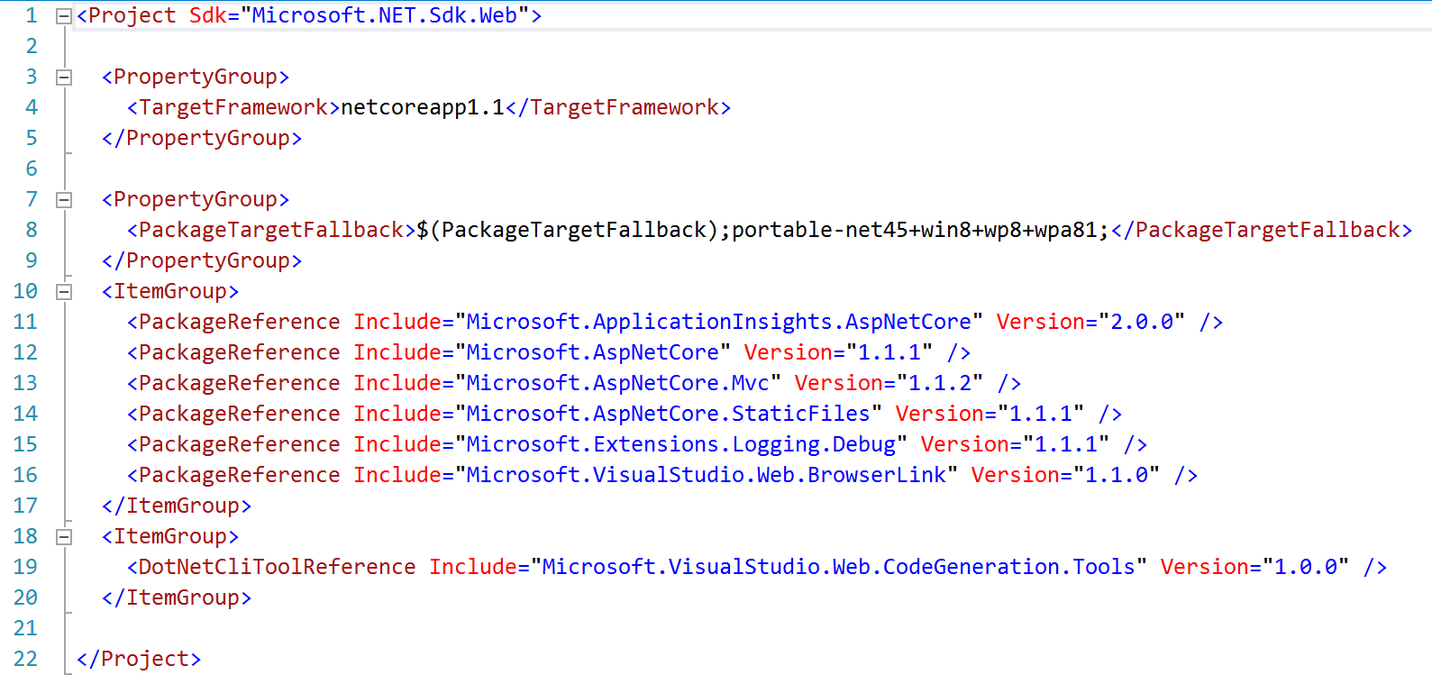
Example: .NET Core 1.0 references

Slide 20
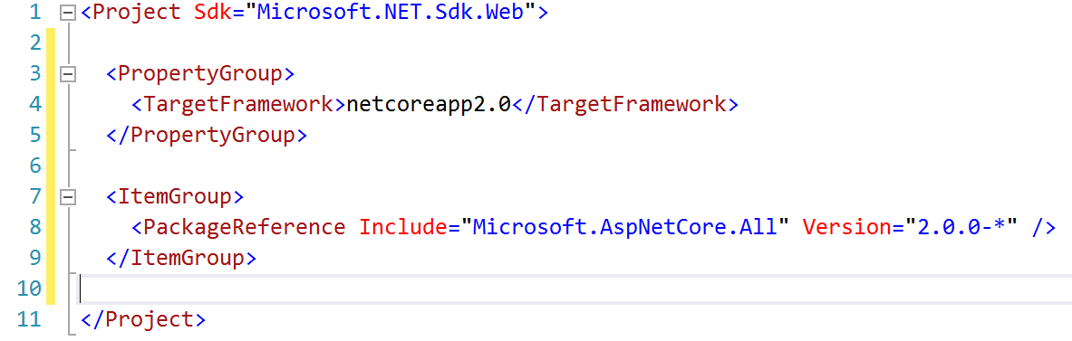
Example: .NET Core 2.0 references

Slide 21
Tooling

Slide 22
Visual Studio 2017
Improved performance, new install experience
Faster navigation
Code style configuration and enforcement
Live Unit Testing
IntelliSense improvements
New exception helper
More refactorings and quick fixes
C# 7.0

Slide 23
Coming in Visual Studio 2017 Update 3
Additional polish to navigation and IntelliSense
.NET Core support for Live Unit Testing
Code style enforcement on builds
More live diagnostics on API design, security, etc.
Even more refactorings and quick fixes
C# 7.1

Slide 24
.NET Core and Visual Studio for Mac
Provide the SAME experience across Windows and Mac
Sharing components with Visual Studio
.NET Core Project Templates
HTML, CSS, JSON editors
Backend debugger
Azure Publish infrastructure
Future
Javascript, Razor editors

Slide 25
.NET Core and Visual Studio for Mac
Full .NET Core Tooling including round tripping between Windows and Mac
Docker Containers with debugging
Publish to App Service
Publish to App Service Containers
Azure Functions

Slide 26
Demo: Visual Studio for Mac

Slide 27
Resources
.NET Core 2 SDK
https://www.microsoft.com/net/core/preview
VS 2017 Update 3 Preview
https://www.visualstudio.com/vs/preview/
.NET Architecture
https://www.microsoft.com/net/architecture
Editor Productivity & Refactoring Cheat Sheet
https://www.visualstudio.com/vs/net-productivity/

Slide 28
¿Preguntas?

Slide 29
¡ Gracias!
Mariano Sánchez
sanchezmariano@outlook.com @marianosz
http://weblogs.asp.net/marianos

